Slide 1
Study plan, Material preparation & Ethical considerations
Week 5

Slide 2
Recap
In Week 4
  Types of behavioural research
  Forming a Research question and developing research hypotheses
  Variables in the context of usability testing
  Experimental research & experimental design
This week we will look
  Create Test Plan
  Test Material preparation
    To inform users
    To instruct moderators
    To collect data at various stages of the study, pre-during-post
  Ethical considerations

Slide 3
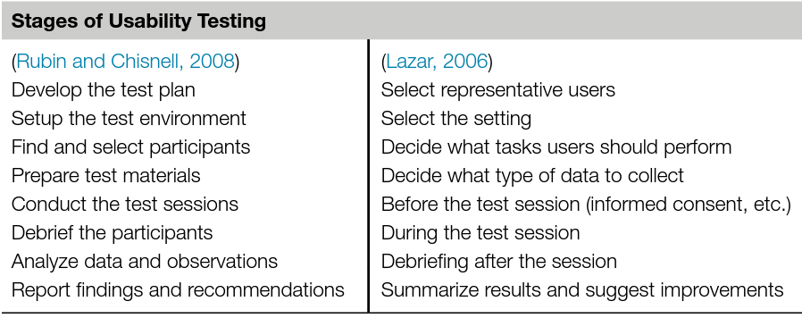
Stages of Usability Testing
Rubin, J., Chisnell, D., 2008. Handbook of Usability Testing, 2nd. ed. Wiley Publishing, Indianapolis.
Lazar, J., 2006. Web Usability: A User-Centered Design Approach. Addison-Wesley, Boston.

Slide 4
Test Plan
Defines the objectives of the usability test, including what specific aspects of the product or system you want to evaluate.
1
Identifies the target user group or demographic.
2
Specifies the usability test scenarios and tasks that participants will complete during the test.
3
Determines the location and logistics of the usability test, including how many participants you need, the equipment required, and the timeline.
4

Slide 5
Test plan purpose
It serves as a blueprint for the study
The test plan describes exactly how you will go about testing your product
It serves as the main communication vehicle between the team
So people will know what needs to be ready and when
They will know what is their involvement and when
It is a means by which people can provide recommendations and feedback
It defines or implies required resources
It provides a focal point for the test and a milestone
By developing the test in stages it gives time to understand the test objectives and talk to the people who will be involved and accommodate changes
The test plan implies a systematic approach

Slide 6
Create a test plan
The test plan is the foundation for the entire usability testing process
It addresses:
  Why – what are the usability test goals (purpose)
  How – what test method
  Where – test setting
  Who – participants, moderators, observers
  What material will be used

Slide 7
Communicate the test goals
It describes the issues and questions that need to be resolved and focuses the research, as well as the rest of the activities associated with planning, designing and conducting the test
It is essential that the research questions be as precise, accurate, clear and measurable (or observable) as possible
Even when the test is exploratory, it is still needed to have accurate description of what you hope to learn

Slide 8
What test method
This part describes the test method that will be used:
  Moderated
  Unmoderated
  Local
  Online
  What will be the role of the moderators
  What participants will be needed and how they will be used

Slide 9
What is the experimental design
How the users will be exposed to the test material
  within
  between

Slide 10
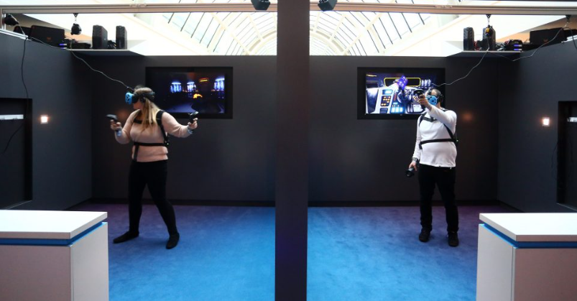
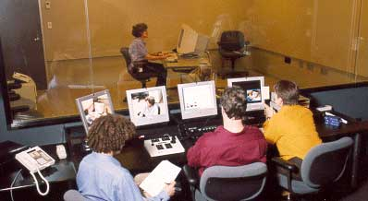
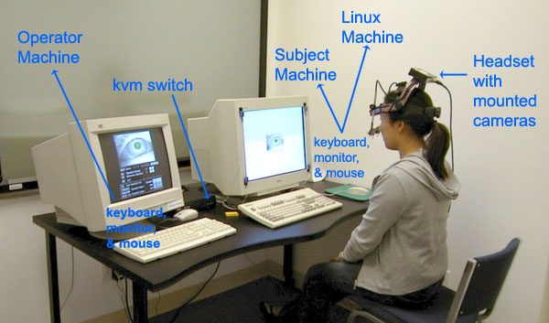
Test settings
Lab
User real context
Equipment required for recording the data

Slide 11
Who - Participants
Describe the characteristics of the end user(s) of the product/document that will be tested

Slide 12
How many users
Many UX researchers say that five users will reveal approximately 80% of usability problems in an interface (Virzi, 1992 )
Nielsen and Landauer expressed that the appropriate number depends on the size of the project, with seven users being optimal in a small project and 15 users being optimal in a medium-to-large project (Nielsen and Landauer, 1993).
In an analysis of existing research on the topic, Hwang and Salvendy (2010) suggest that 10 ± 2 is the optimal number of users for usability testing, although more recent work by Schmettow (2012) suggests that even 5 users is enough to discover 80% of the usability problems.

Slide 13
How many users for statistically valid results?
A sample size of 30 is fairly common across statistics. A sample size of 30 often increases the confidence interval of your population data set enough to warrant assertions against your findings.
The higher your sample size, the more likely the sample will be representative of your population set
For true experimental design you must have at least 10-12 participants per condition

Slide 14
Who – the role of the moderator/s
Facilitating the Usability Test
The moderator is responsible for conducting the usability test sessions, during which participants interact with a product or system. They create a comfortable and encouraging environment for participants.
Explaining the Purpose and Process
Before the test begins, the moderator explains the purpose of the usability test to participants. They clarify that the focus is on evaluating the product, not the participant's abilities.
Obtaining Informed Consent
The moderator ensures that participants provide informed consent to participate in the usability test, including recording and observation, if applicable.
Creating a Comfortable Atmosphere
The moderator establishes a rapport with participants and creates a non-judgmental, stress-free atmosphere to encourage participants to provide honest feedback.
Providing Instructions
The moderator gives clear, concise instructions to participants regarding the tasks and scenarios they need to complete during the test. They also instruct participants to think aloud while interacting with the product.
Monitoring and Observation
During the test, the moderator closely observes the participant's interactions, noting their behavior, comments, and any difficulties they encounter.
Asking Follow-Up Questions
The moderator may ask follow-up questions to probe deeper into the participant's thought process, such as asking why they made a particular choice or how they felt about a specific interaction.
Recording Observations
The moderator keeps detailed notes about the participant's interactions, challenges, feedback, and any notable observations. These notes provide valuable qualitative data.
Ensuring Objectivity
The moderator maintains objectivity and avoids leading questions or providing assistance that might bias the results.
Managing the Session Time
The moderator is responsible for keeping the session on schedule to ensure that each participant completes the assigned tasks within the allotted time.
Addressing Technical Issues
If technical issues arise during the usability test, the moderator may help troubleshoot or document the issues to ensure they do not interfere with the participant's experience.
Closing the Session
At the end of each usability test session, the moderator may thank the participant, provide any necessary debriefing information, and answer any participant questions.
Debriefing and Data Analysis
The moderator may participate in debriefing sessions with the research team to discuss their observations and insights. They contribute to the analysis of the usability test findings.

Slide 15
Test Material Preparation/Research instruments
Orientation script/Participant Information Sheet (PIS), Informed consent
Software/Prototype
Data collection instruments (DCI):
  Task scenarios
  Screening/Pre-test questions
  In-test questions and data collected during the test
  Post-test data collection (Self-reported data)
Nondisclosure agreement and recording consent form
Some other documents you may need to prepare is:
  Training material for users
  Instructions for moderators to conduct the test

Slide 16
Orientation script/Participant Information Sheet (PIS), Informed Consent
It is a document for the user
It is a document that describes what will happen during a test session:
  The test procedure
  What is expected from the users
  What is the role of any other people participating (e.g. moderator, observer/s)
  What data will be collected and how it will be used (e.g. published and were)
  Ask users if they want to be informed about the study output
Explaining clearly the fact that the product, not the participant, is being tested.
That the participants may withdraw at anytime
How the results will be used and how the participant's data will remain confidential
That the participant may decide that his or her results will not be used

Slide 17
(DCI) Task scenarios
Data collection instruments
  Task scenarios
  Screening/Pre-test questions
  In-test questions
  Post-test questions
Task scenarios are representations of actual work that the participant would conceivably perform using the product to be tested
Task scenarios should describe:
  The result that the participant will strive to achieve
  Motives for performing the work
  Actual data and names rather than generalities
  The state of the system when the task is initiated
  Readouts of displays and printouts that the participants will see while performing the task

Slide 18

Screening/pre-test questions
Data collection instruments
  Task scenarios
  Screening /Pre-test questions
  In-test questions
  Post-test questions
The people you invite to testing should represent your target audience—they should be your real or potential users. You need to specify a criterion that defines your ideal participant and evaluate all your candidates according to this standard.
The user testing questions that you ask during the screening process should help you understand both the demographics and experience of your candidates.
Collect demographic data - age, race, ethnicity, gender, marital status, income, education, employment, prior education or experience, habits, other such as:
  How often do you [do something]?
  What apps and websites do you use on a regular basis?
  Which device do you typically use to [do something]?
  Have you used this product before?

Slide 19
Screening/pre-test questions
Data collection instruments
  Task scenarios
  Screening /Pre-test questions
  In-test questions
  Post-test questions
To determine participants’ attitudes and first impressions about the product’s ease of use prior to using it
  Does the product look easy to use?
  Does the participant understand the terminology?
  Is the product similar or very different from other products, or even from previous releases of the same product?
  Establish the participant’s prerequisite knowledge
To qualify the group that the participants best fit in (e.g. it could be a skills test to group the participants)

Slide 20
In-test questions
Data collection instruments
  Task scenarios
  Screening /Pre-test questions
  In-test questions
  Post-test questions
These user testing questions will help you discover important insights about user behaviour when they interact with your product.
In this phase, you allow participants to interact with your product, observe their interactions, and ask relevant questions.
Aim to collect data that explains user behaviour (i.e., why users make certain actions, why they prefer one option versus another, etc).
  What features do you find most valuable and why?
  Can you give me a few examples of real situations when you would do [something]?
  What do you think about this design [specific features]?
  What prevents you from completing a task?
  I noticed you [did something]. Why?

Slide 21
In-test questions
Data collection instruments
  Task scenarios
  Screening /Pre-test questions
  In-test questions
  Post-test questions
Fully automated data loggers
  Programs generate logs for user actions, errors, task completion, timing, dialog etc.
Online data collection /self-reported data
  The observer fills an online form
User-generated /self-reported data
  The user fills printed/or online questionnaires
Manual data collection
  The observer fills written or online questionnaires
Other data collection methods
  Create shorthand notes
Shorthand note | Data collected
B | Begin task
E | End task
C | Click
S | Submit
P | Prompted by moderator
M | Exceeded time allotted
X | Incorrect action
CC | Completed correctly

Slide 22
Post-test questions
Data collection instruments
  Task scenarios
  Screening /Pre-test questions
  In-test questions
  Post-test questions
The moment right after the user testing session has been completed is a perfect time to ask test participants if they have questions or anything to add so you can collect more of their personal opinions/preference information to help clarify and deepen understanding of the strengths and weaknesses of a product
It includes information about the users:
  feelings
  opinion
  ease of use and ease to learn
  about the product
  How difficult are these test assignments? (1=very easy, 5=very difficult)
  How would you describe your overall experience with this product?
  If you could change one thing in this product, what would it be and why?
  What do you expect to see in our product in the future?

Slide 23
Research question – associated data
Research question | Data collected
How easy is it to perform a specific task using a new hardware product? | Percentage of users that completed the task Number of steps required to perform the task How long it took them to do the first click Errors they might have encountered User opinion – via a scale
Do novice participants access the sitemap? | Number of unsolicited accesses of the site map before completing the task And Explanation of what participants were looking for in the navigation categories that they did not find
How accessible is information in the Contact us section of the website? | Time expired between searching for a specific piece of information and locating it on the correct page
How effective is a tutorial in teaching a specific task? | Time expired between accessing the tutorial and successful completion of the task Or Comparison of error rates of participants using and not using the tutorial

Slide 24
Common Post-Task Usability testing questionnaires
There are several common post-task usability testing questionnaires that adhere to established standards and guidelines for assessing usability and UX. These questionnaires are widely used in the field of HCI and can help provide structured and reliable data about a system's usability.
Here are some commonly used standards-based post-task usability testing questionnaires:
System Usability Scale (SUS) is a reliable and validated questionnaire commonly used post-task evaluation. It consists of ten standardized items. (Brooke, J. (1996) SUS—A Quick and Dirty Usability Scale. Usability Evaluation in Industry, 189, 4-7)
Post-Study System Usability Questionnaire (PSSUQ) is a standardized questionnaire designed to measure participants' perceptions of system usability after they have completed tasks (Lewis, J. R. (1992). Psychometric Evaluation of the Post-Study System Usability Questionnaire: The PSSUQ. Proceedings of the Human Factors Society Annual Meeting, 36(16), 1259-1260. https://doi.org/10.1177/154193129203601617)
After-Scenario Questionnaire (ASQ) ASQ is designed to evaluate usability and user satisfaction with a system after a specific task or scenario. It is structured around attributes like system usefulness, system information, system interface, and user satisfaction. ( Lewis, J. R. (1995) IBM Computer Usability Satisfaction Questionnaires: Psychometric Evaluation and Instructions for Use. International Journal of Human-Computer Interaction, 7:1, 57-78.)
Customized Usability Questionnaires: In some cases, researchers develop customized questionnaires based on established usability principles and guidelines, tailoring them to the specific context and goals of their usability testing.

Slide 25
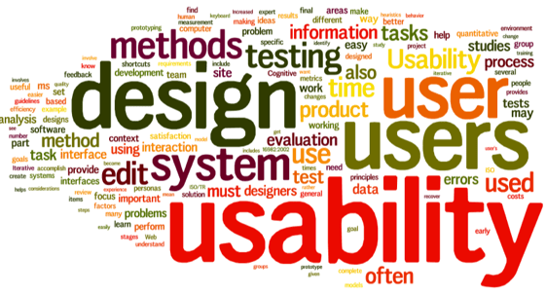
Open-ended questions
Overall Impressions:
  "What are your overall impressions of using this product?"
  "Can you describe your initial thoughts after interacting with the system?"
Likes and Dislikes:
  "What aspects of the product did you like the most?"
  "Were there any specific features or elements you disliked? If so, please explain."
Challenges and Frustrations:
  "Did you encounter any challenges or frustrations while completing the tasks? Please describe them."
  "Were there any moments where you felt stuck or confused?"
Improvement Suggestions:
  "Are there any improvements or changes you would suggest to make this product more user-friendly?"
  "What would make this system easier and more efficient for you?"
User Interface and Design:
  "What are your thoughts on the design and layout of the user interface?"
  "Were there any elements of the interface that you found particularly intuitive or confusing?"
Task-Specific Feedback:
  "For the task where you [describe the task], can you share your thoughts on the process and any difficulties you encountered?"
  "How do you think the system could better support you in [task]?"
Learnability and Training:
  "Did you feel that you needed any training or guidance to use this system effectively?"
  "How quickly were you able to learn how to use the product?"
Comparison with Other Products:
  "How does this product compare to similar products or systems you've used in the past?"
  "Is there anything this system does better or worse than others you've experienced?"
Recommendations:
  "Would you recommend this product to a friend or colleague? Why or why not?"
  "What type of user do you think would benefit most from this system?"
Additional Comments:
  "Is there anything else you'd like to add or any additional feedback you'd like to share?"

Slide 26
Training material for users
Training materials for users are resources designed to help individuals to understand how to interact with the system to be tested if required
It could be:
  Quick start guides offer a condensed version of user manuals, providing users with essential information to get started quickly. They are typically shorter and more focused on the basics.
  Video tutorials are instructional videos that guide users through the process of using a product or software.
  Training Workshops, in-person or virtual training workshops conducted by trainers who guide users through the product or system.
  Interactive demos allow users to explore a product's features and capabilities in a sandbox environment, without making actual changes.

Slide 27
  Instructions for moderators to conduct the test
Instructions to moderators in a usability testing study are essential for ensuring a standardized and effective testing process.
  Welcome and Introduction:
    Begin each session with a warm welcome and introduce yourself.
    Explain the purpose of the usability testing study and the importance of the participant's feedback.
  Informed Consent:
    Ensure that participants have provided informed consent before the session begins.
    Explain the consent form and make sure participants understand that they can stop the session at any time.
  Task Explanation:
    Clearly explain the tasks participants are expected to perform during the session.
    Describe the goals and context of each task.
  Think Aloud:
    Instruct participants to "think aloud" as they interact with the product. Encourage them to express their thoughts, questions, and reactions.
  Non-Interference:
    Emphasize that the moderator should not provide assistance or hints during the tasks.
    Instruct the moderator to remain neutral and not influence the participant's actions.
  Questioning Techniques:
    Encourage the use of open-ended questions to probe deeper into participants' experiences.
    Instruct the moderator to ask follow-up questions when necessary to gather more information.
  Note-Taking:
    Explain the importance of taking detailed notes during the session.
    Provide guidelines on what to document, including observations, issues, and participant comments.
  Recording:
    Ensure that the session is being recorded, both in terms of audio and video if applicable.
    Instruct the moderator on how to operate recording equipment.
  Time Management:
    Stress the importance of keeping the session on schedule to allow each task to be completed.
    Encourage the moderator to be mindful of the time but avoid rushing the participant.
  Participant Comfort:
    Instruct the moderator to create a comfortable and non-judgmental atmosphere for participants.
    Ensure that participants feel at ease and are encouraged to provide honest feedback.
  Handling Technical Issues:
    Provide guidance on how to address technical issues if they arise during the session.
    Ensure that the moderator knows how to troubleshoot common problems.
  Debriefing:
    After each session, instruct the moderator to thank the participant and offer a brief debriefing.
    Allow participants to ask questions or provide additional feedback.
  Confidentiality and Data Security:
    Remind the moderator of the importance of protecting participant privacy and data security.
    Provide guidelines on how to handle and store participant data.
  Diversity and Inclusivity:
    Emphasize the importance of being respectful and inclusive, especially when working with a diverse group of participants.
  Reporting:
    Explain how the moderator should report their findings, including observations, issues, and recommendations.
    Provide templates or guidelines for reporting.
  Continual Learning:
  Encourage moderators to reflect on their sessions and continually improve their skills as facilitators.

Slide 28
Do’s and don’ts of usability testing
Here are some practical recommendations to help you to gather more valuable user insights during a usability testing session

Slide 29
Do’s during usability testing
Use think-aloud protocol
Ask more open-ended questions
Watch participant’s facial expressions and body language
Ask follow-up questions
Record answers on video

Slide 30
Don’ts during usability testing
Ask leading questions
  Do you like our new design more than the old one?
  Does the app help you work more efficiently?
  When do you think that feature X would
Provide too many details
Provide too much guidance
Judge the participants
Take user words for granted

Slide 31
Ethical Considerations when conducting usability testing
Ethical considerations in usability testing help ensure the well-being, privacy, and rights of participants and the integrity of the research process.

Slide 32
Ethical considerations for usability testing
Informed Consent: Participants must provide informed and voluntary consent to participate in usability testing. They should be fully aware of the purpose of the test, any data collection methods, and their rights as participants. Consent should be obtained in writing or orally, depending on the context.
Privacy and Confidentiality: Protect the privacy of participants by ensuring that any personal or sensitive information is kept confidential. Use anonymization techniques to de-identify data and prevent the disclosure of participants' identities.
Data Security: Safeguard participant data from unauthorized access or data breaches. Ensure secure storage and transmission of data, especially if you collect sensitive information.
Deception: Avoid deception in usability testing. Participants should not be misled or provided with false information about the purpose or nature of the test.
Honesty and Transparency: Be transparent about the research objectives and methodologies. Participants should know what to expect during the testing process.
Safety: Ensure that usability testing does not pose any physical or psychological harm to participants. Monitor participant well-being and provide support if any distress occurs.
Compensation: If participants are compensated for their time and effort, ensure that the compensation is fair and does not create undue influence.

Slide 33
Ethical considerations for usability testing
Recruitment: Be cautious when recruiting participants, avoiding undue pressure or coercion to participate. Recruitment should be unbiased and not target vulnerable populations.
Feedback: Encourage open and honest feedback from participants, but do not pressure them to provide positive feedback or engage in unethical practices to improve test results.
Accessibility: Make sure that the usability testing environment and materials are accessible to participants with disabilities. Provide accommodations as needed to ensure equal participation.
Withdrawal: Inform participants of their right to withdraw from the study at any time without consequences.
Data Usage: Clearly communicate how the data collected during usability testing will be used and shared. Ensure that data is used only for research purposes and is not exploited for other purposes without participants' consent.
Review by Ethics Committees: In some cases, usability testing involving vulnerable populations or sensitive data may require review and approval by an ethics committee or institutional review board (IRB).
Respect and Dignity: Treat participants with respect and dignity throughout the usability testing process. Be considerate of their time and needs.
Post-Testing Debriefing: After usability testing, provide participants with a debriefing session where they can ask questions, receive feedback, and express any concerns.

Slide 34
University of Westminster Code of Practice Governing the Ethical Conduct of Research 2020/21
UoW: https://www.westminster.ac.uk/research/research-governance/research-and-knowledge-exchange-ethics
https://www.westminster.ac.uk/sites/default/public-files/general-documents/Ethics-Code-Of-Practice.pdf
Look also Research Data Protection and Security(University’s Ethics Code of Practice

Slide 35
UoW Ethics Approval process
Part A
Part B
Students should begin the process of consideration of research ethics approval by completing an Application Cover Sheet and the Part A application form. If there are minimal ethical implications – see the decision tool at the end of Part A - then they will not need to complete the Part B application form.
If the research raises ethical issues, the student will be asked to complete Part B of the application.

Slide 36
Summary
What we covered in week 5
  Create Test Plan
  Test Material preparation
    To inform users
    To instruct moderators
    To collect data at various stages of the study, pre-during-post
  Ethical considerations
Next week (week 6) engagement week (work on the CW) – then we will continue with Descriptive Statistics
  Descriptive statistics concepts and Graphs

Slide 37
Test your understanding
What is the purpose of the test plan and what is the information it contains?
What are the possible test methods to consider in usability testing experimental design?
What are the possible usability test settings?
What are the issues to consider about the participants to take part in a study?
How many participants do we need to recruit to collect data that can lead to statistically valid results?
What is the role of the moderator?
What is the content of the
What are the research instruments we need to prepare for a usability testing study?
What is the content of the Orientation script/Participant Information Sheet (PIS)?
What type of screening data do we collect and why?
What type of in-test data do we collect and how?
What type of post-test data do we collect and how?
What type of questionnaires we can use to collect usability testing data?
What is the content of the Nondisclosure agreement and recording consent form?
What is the content of training material for users
What are the instructions for moderators to conduct the test?
What are the ethical considerations of a usability testing study?

Slide 38
Reading
Lazar, J. et al. (2017) Research methods in human-computer interaction. Second edition. Cambridge, Massachusetts: Morgan Kaufmann Publishers.
  Chapter 3 Experimental design
  Chapter 5 Surveys
Tullis, T. (Thomas) et al. (2013) Measuring the user experience : collecting, analyzing, and presenting usability metrics. 2nd ed. Amsterdam, Netherlands: Elsevier.
  Chapter 3 Planning
  Chapter 4 Performance Metrics
  Chapter 5 Self-Reported Metrics
Carol M. Barnum (2020) Usability testing essentials, Ready, Set... Test!, Morgan Kaufmann.
  Chapter 8, Prepare test material
Rubin, J. & Chisnell, D. (2008) Handbook of Usability Testing: How to Plan, Design, and Conduct Effective Tests,Wiley.
  Chapters 5 – 8.
Online Resources
The art of asking questions in UX Research
  https://www.akendi.com/blog/the-art-of-asking-questions/
The art of asking research questions in usability testing
  https://www.akendi.com/blog/the-art-of-asking-questions-in-usability-testing/
Usability testing Research ethics
  https://www.nngroup.com/articles/user-research-ethics

